Slide 1
SMART ENTRANCE FOR CORONA PROTECTION
Presented By-
1705013-Md. Olid Hasan Bhuiyan
1705025-Swapnil Dey
1705034-Souvik Das
1705104-Anik Islam

Slide 2
OBJECTIVE OF OUR PROJECT
To check if the person entering the compound is not a carrier of covid-19 virus by checking his temperature
To ensure minimum safety from corona virus by using automated handwash to wash his/her hands

Slide 3
MODULES
1. RFID ID card punch
2. Temperature Check
3. Automated Handwash

Slide 4
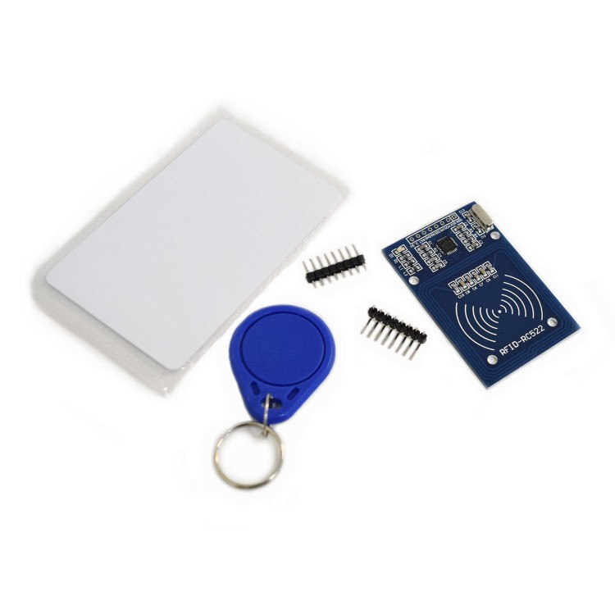
RFID CARD PUNCH -To check if he/she is an employee of the office
COMPONENTS
RFID CARD(RC522)
RFID READER WITH SERIAL INTERFACE
RX PIN
LED
BUZZERS
ATMEGA32

Slide 5
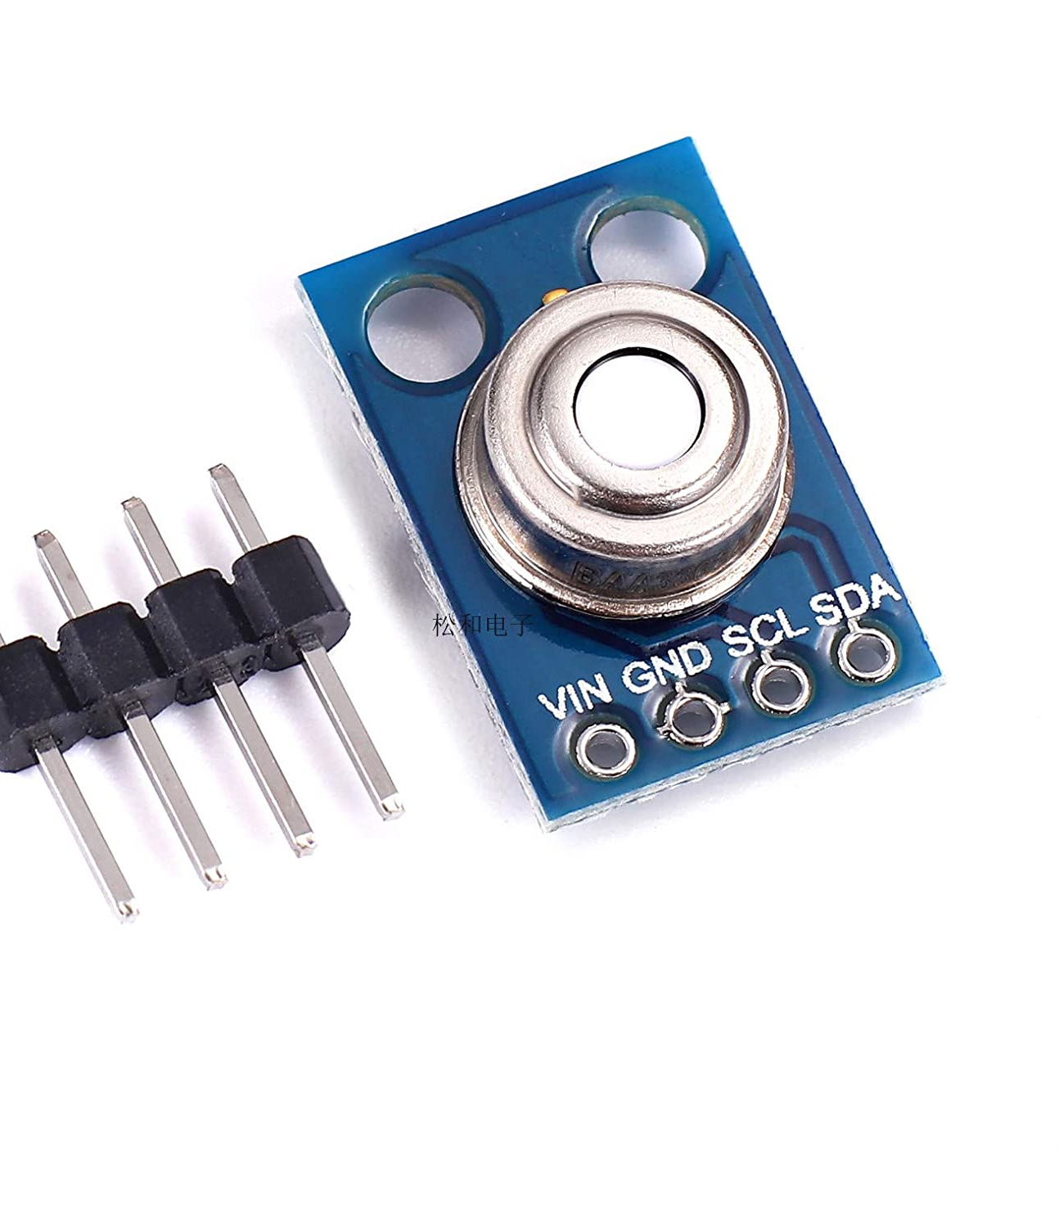
TEMPERATURE CHECK -To ensure whether the person is covid positive or not
COMPONENTS
1. MICRO SERVO MG90S
2. LCD 2004 11C 12C
3. PIR MODULE HC-SR501
4. IR TEMPERATURE SENSOR(GY906 MLX90614ES)
5. LED DIODE
6. RESISTOR
7. BURNER(Multiple)

Slide 6
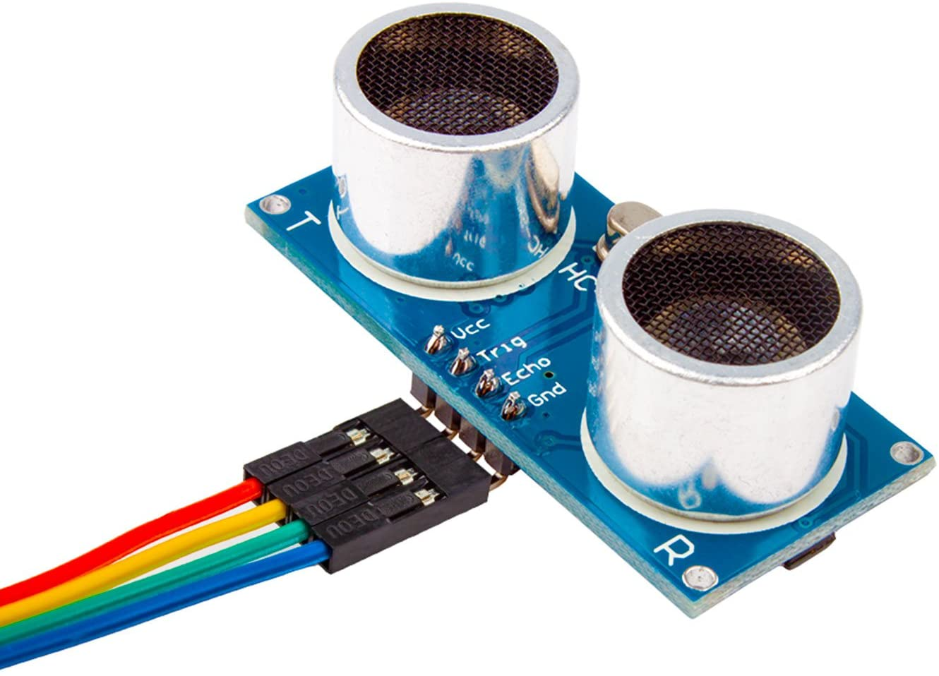
AUTOMATED HANDWASH - TO SANITIZE HANDS
COMPONENTS
IR PROXIMITY SENSOR/ OBSTACLE DETECTING SENSOR
TIP32C PNP TRANSISTOR/BC547B_ELNINO TRANSISTOR
RESISTOR
BREADBOARD(Multiple)
ULTRASONIC DISTANCE SENSOR(HC-SR04)
HANDWASH
ATMEGA32
BATTERY(12v,5v)
SUBMERSIBLE WATERPUMP

Slide 7

THANK YOU

